Slide 1
PROTOPLAST CULTURE
PRESENTED BY:
AKANSHA CHAUHAN
ROLL NO. : 190100227002
M.Sc. BIOTECH – 2ND SEM
CH. CHARAN SINGH UNIVERSITY MEERUT

Slide 2
CONTENTS
INTRODUCTION
STEPS OF PROTOPLAST ISOLATION
METHODS OF PROTOPLAST ISOLATION
PURIFICATION OF PROTOPLAST
CULTURE OF PROTOPLAST
METHOD OF PROTOPLAST CULTURE
MECHANICAL METHODS
ENZYMATIC METHODS

Slide 3
INTRODUCTION
Protoplast is a living cell containing all cellular components except cell wall.
A naked cell surrounded by a plasma membrane.
It can regenerate cell wall grow and divide.
Fragile but can be cultured and grow into a whole.

Slide 4
HISTORY
Term protoplast was introduced in 1880 by Hanstein.
First isolation of protoplast achieved by Klercker(1892).
E.C. Cocking in 1960, he was first who used enzymatic method to isolate protoplast.
Rakabe and his associate (1971) regenerated a whole tobacco plant from protoplast.

Slide 5
IMPORTANCE
IMPORTANCE OF PROTOPLAST CULTURE ARE AS FOLLOWS:
The Protoplast in culture can be regenerated into whole plant.
Protoplast are excellent material for ultra structural studies.
Protoplast are useful for membrane studies.

Slide 6
STEPS OF PROTOPLAST ISOLATION
Selection of plant and explant.
Surface sterilization of explant.
Pelling off the epidermis.
Incubation in enzyme.

Slide 7
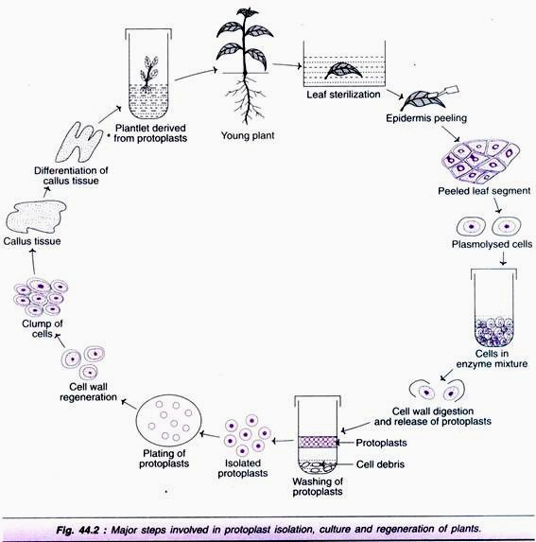
STEPS OF PROTOPLAST ISOLATION

Slide 8
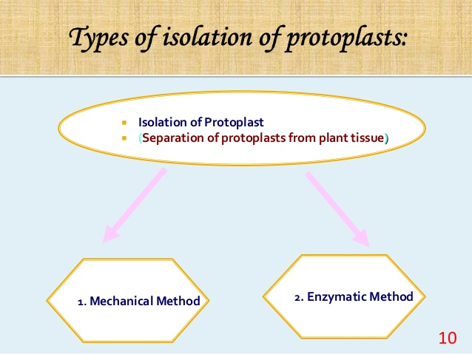
METHODS OF PROTOPLAST ISOLATION

Slide 9
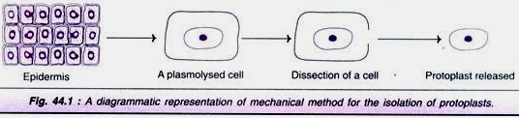
MECHANICAL METHOD
1. First done by Klercher (1982).
2. Using dissection tools .
3. Cut the tissue which are first plasmolysed with a sharp knife into a small pieces .
4. these pieces are deplasmolysed by using dilute solution to release protoplast.

Slide 10
LIMITATIONS
Yield of protoplast is low.
The method is laborious and tedious.
Restricted to vaculated cell.

Slide 11
ENZYMATIC METHOD
Widely used technique for isolation of protoplast.
Use of enzyme to dissolve the cell wall for releasing protoplasts.
Easy to perform, more protoplast viability.
INVOLVES TWO METHODS:
Direct Method (one step only)
Sequential Method (two steps only)

Slide 12
DIRECT METHOD
Incubation of leaf segments overnight in enzyme solution.
Mixture is filtered and centrifuged.
Protoplast forms pellet.
Then washed with sorbitol and re-centrifuged.
Clean protoplast float.
They are pipetted out.

Slide 13
SEQUENTIAL ENZIMATIC METHOD
This method was used by Takebe in 1968 in two steps.
The macerated tissue was first incubated in pectinase and then treated with cellulase for libration of protoplast.

Slide 14
PURIFICATION OF PROTOPLAST
Protoplast are purified by removing
Undigested material (debris)
Brusts protoplast
Enzymes

Slide 15
CULTURE OF PROTOPLAST
Isolated protoplast can be cultured in an appropriat medium to reform cell wall and generate callus.
Optimal culture conditions.
Protoplast culture in suitable media first generate a new cell wall.
The formation of a complete cell with a wall.
The first cell division may occur within 2-7 days of culture.
Resulting in small clumps of cells also known as micro colony within 1-3 weeks.
Optimal density to the culture
Temperature 20 – 28 degree celsius
pH : 5.5 – 5.9

Slide 16
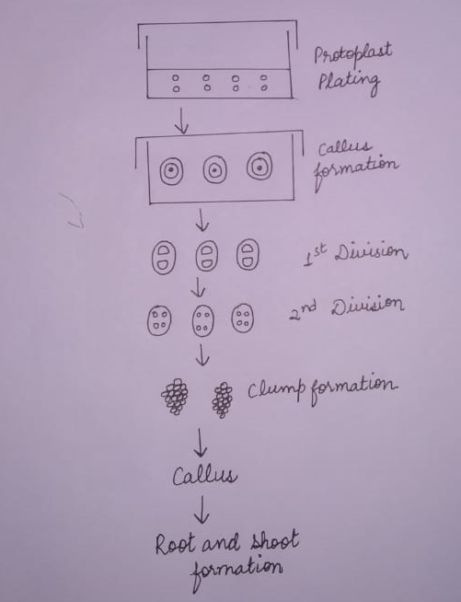
STAGES OF PROTOPLAST CULTURE

Slide 17
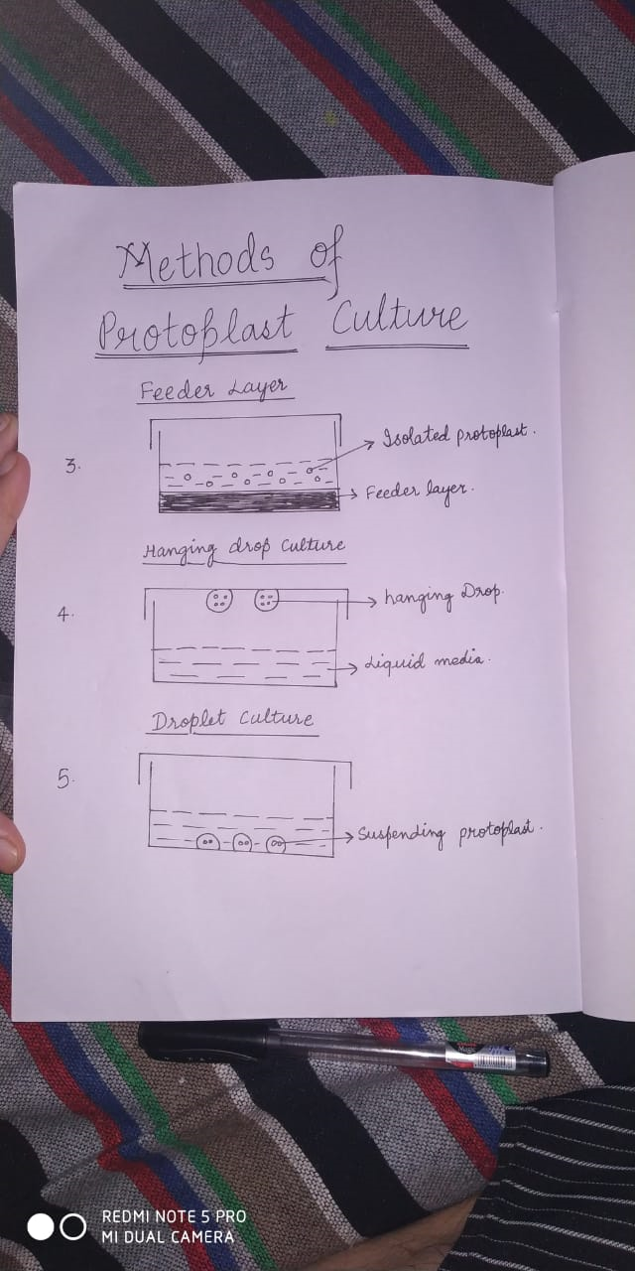
METHODS OF PROTOPLAST CULTURE
Agar media (semi-solid form)
Liquid media
Feeder layer

Slide 18
METHODS OF PROTOPLAST CULTURE
Hanging drop culture
Droplet culture

Slide 19
THANK YOU

